Slide 1
Using practice exams effectively

Slide 2
Testing yourself > Reading solutions
Testing yourself is more effective for your learning!
But also...
Notes:
We saw in last week’s workshop that testing yourself is more effective than studying / rereading. This means that testing yourself by actually trying to do practice exams is much more effective than just reading the solutions.

Slide 3
A study
Participants were given a practice test followed by an actual test.
Half of the participants were permitted to look at the answers to the practice test while they took it.

Slide 4
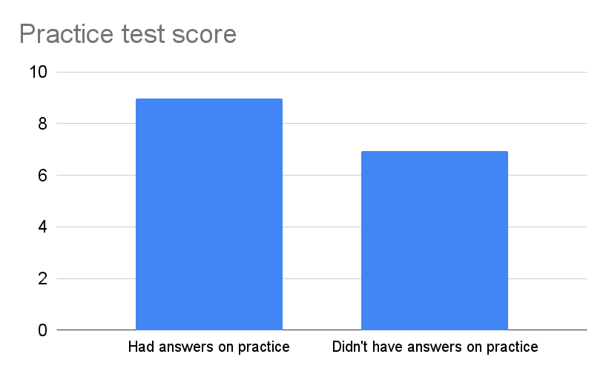
A study
Notes:
It’s not surprising that the people who had answers did better! But it’s a pretty strong indication that they did look at the answers.

Slide 5
A study
All participants were asked to predict how they’d do on the actual test.
What do you think the two groups predicted?
Notes:
Give students a minute to discuss.

Slide 6
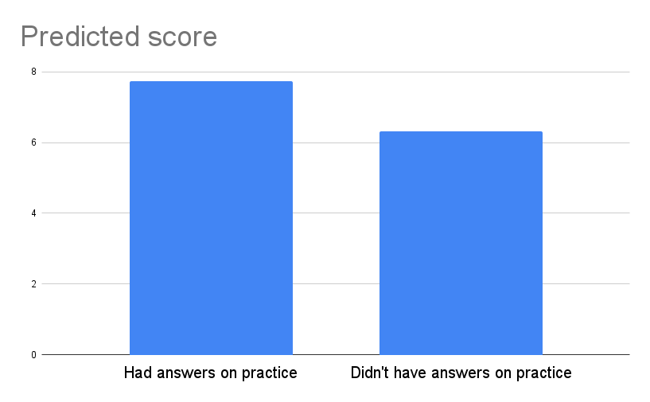
A study

Slide 7
A study
But the 2 groups did about the same on the actual test.
So, those with the answers experienced a bigger mismatch between how they thought they would do and how they actually did.

Slide 8
So, looking at solutions while taking a practice exam really isn’t helpful.
Our sense of how much we really understand can become inflated.

Slide 9
What should you do instead if you get stuck on a problem?
Take a few minutes to brainstorm.

Slide 10
Things to try
Look back at your worksheets, homework, and notes for other problems on the same topic. Using those, can you make progress?
If not, read the first few sentences of the solution, and then try to solve the rest of the problem on your own. Only turn back to the solutions if you get stuck again.

Slide 11
If you need to look at the solution...
After you’re done with the problem, spend a few minutes thinking about how you’ll recognize a similar problem in the future.
Come back in a day or two and try doing the problem without the solution.

Slide 12
Here’s a practice exam method in practice:
Assume we have a practice exam problem.
First, we try to solve it without any help.
We get as far as we can, and jot notes, questions, or ideas about where we’re stuck.
Next, we open resources - worksheets, homework, notes, and try to solve the problem. The notes we wrote are our guide.
Only after doing this with every problem do we check the solutions.
1.

Slide 13
Here’s a practice exam method in practice:
Assume we have a practice exam problem.
Color-coding in this way helps us see what we can do on our own vs what we can do with aids.
We are less likely to misjudge the level of our own understanding.
We can focus in on this question:
What piece of information or understanding would’ve allowed me to get from the last “penciled” line in grey to the first blue line?
1.

Slide 14


